Slide 1

Smart tube
Makeathon 2019
Idea presentation

Slide 2

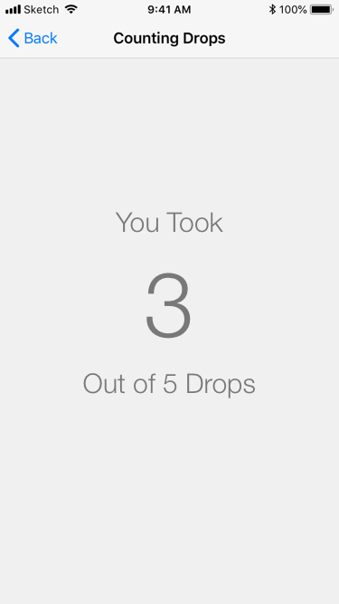
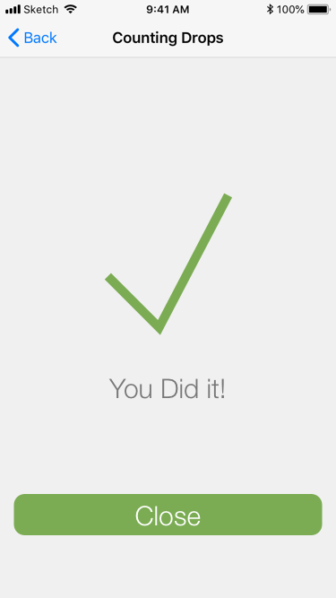
Mock-up

Slide 3
Main concept/ Functions
Drop count
History
Reading out instructions
Expiration and product left

Slide 4
Approach
Measuring the drop count with infrared sensor (or photoresistor)
Webserver on ESP32 TCP Request for control

Slide 5
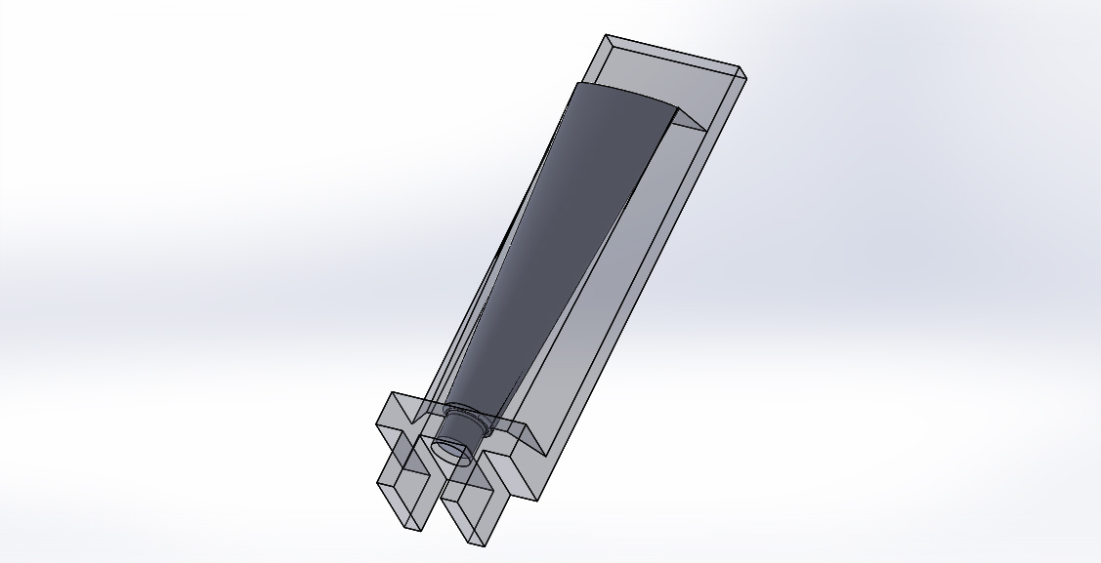
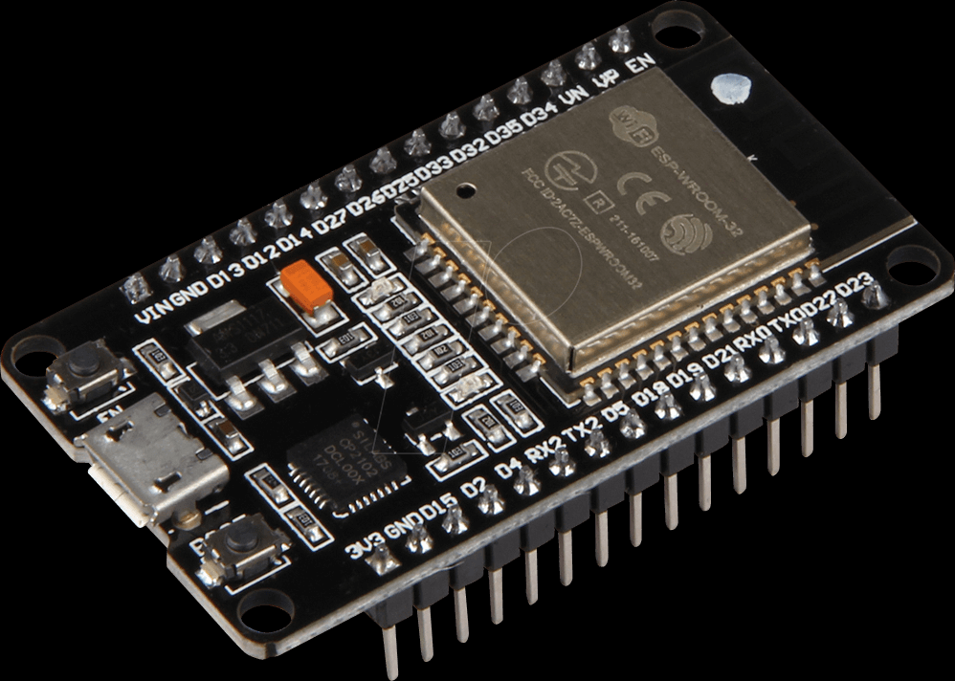
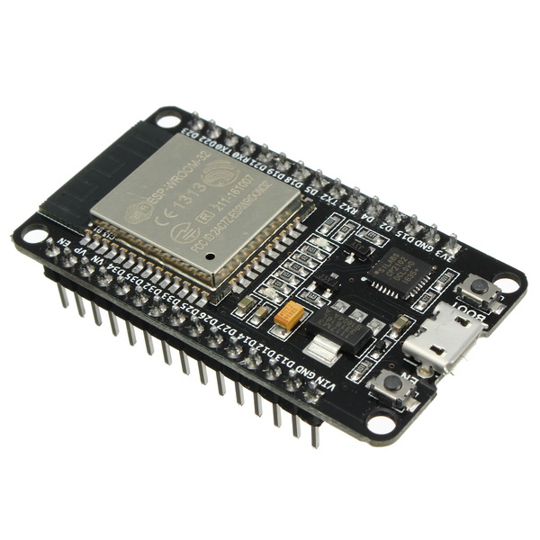
Hardware

Slide 6
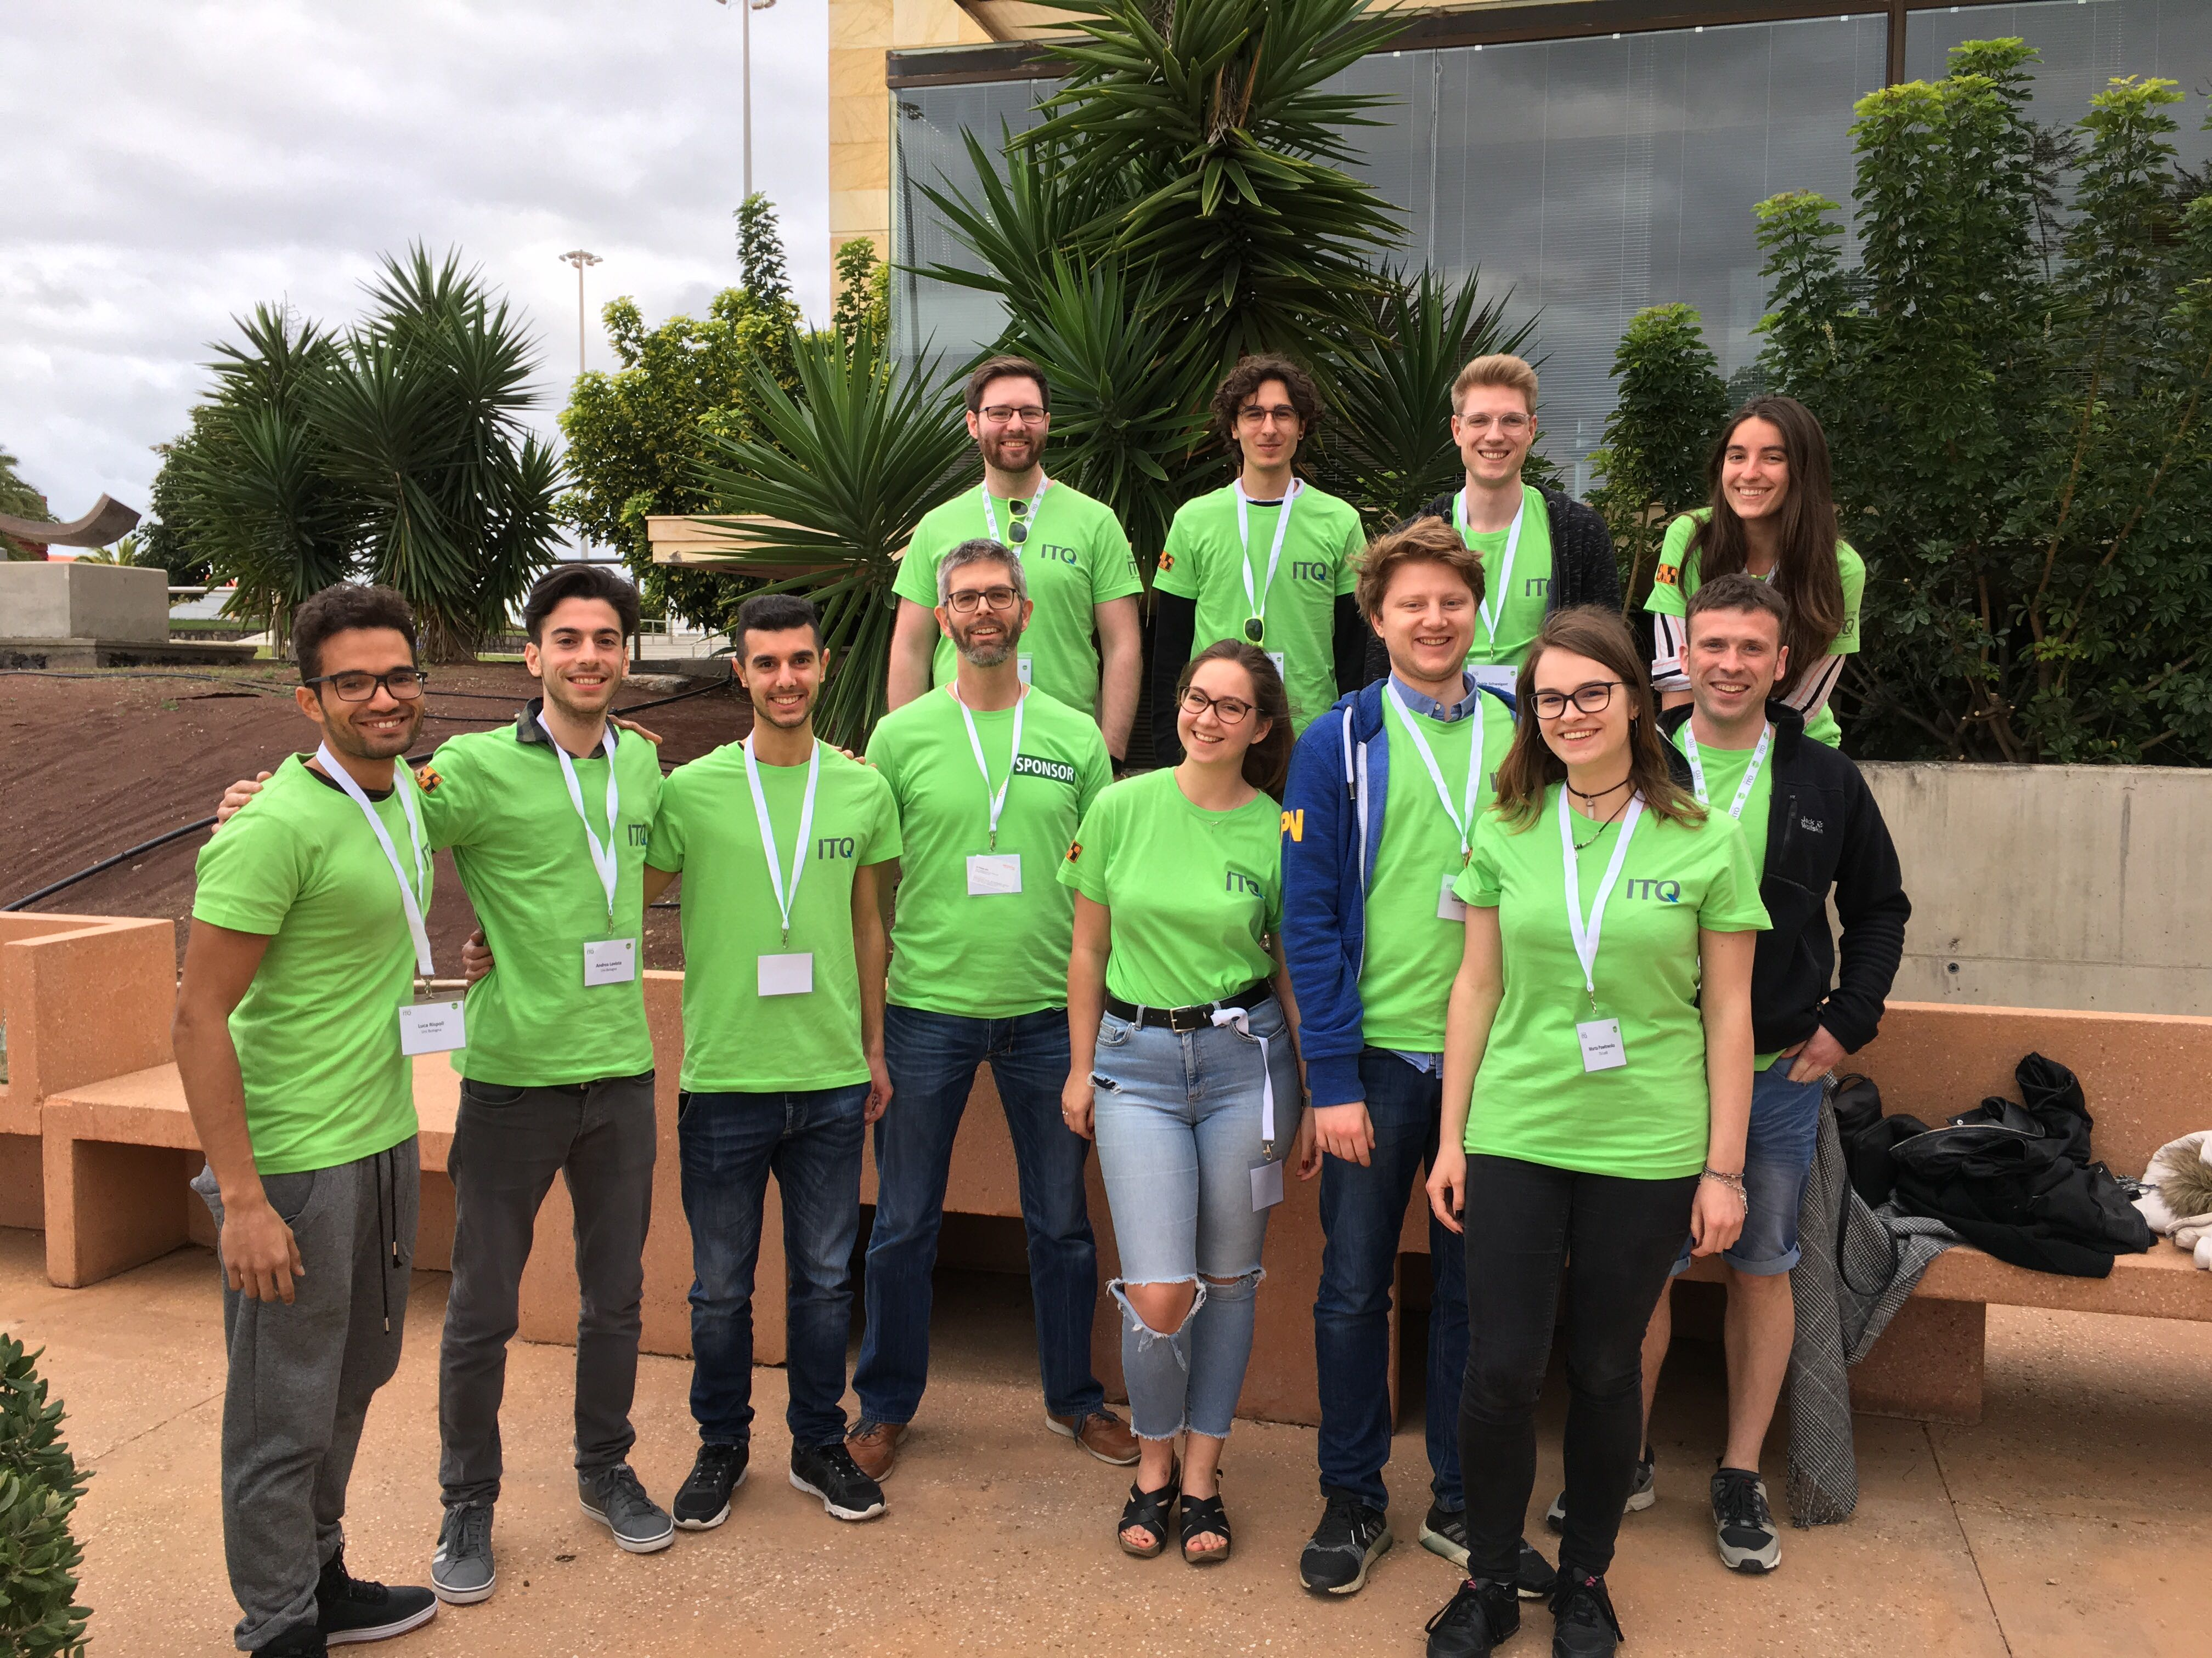
Our team

